Slide 1


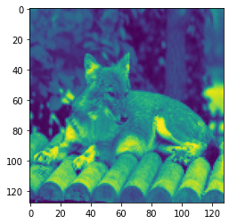
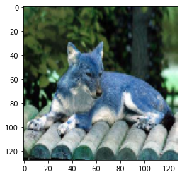
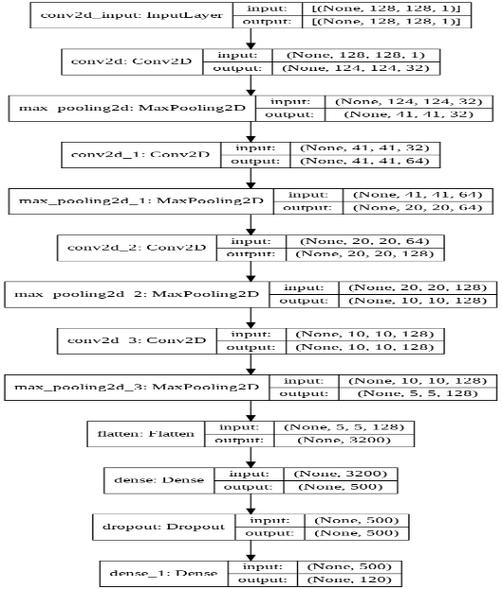
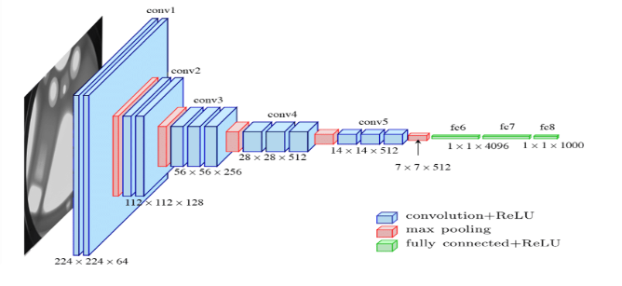
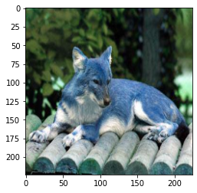
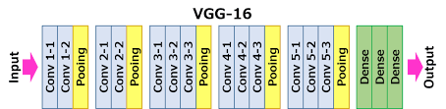
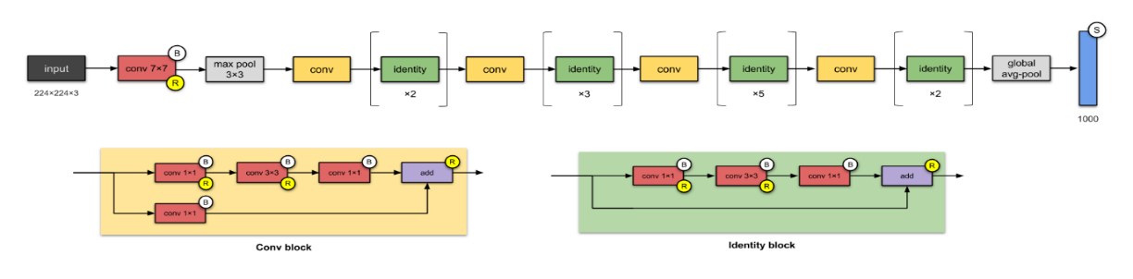
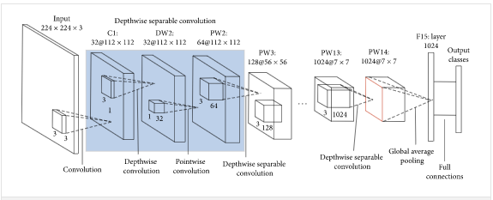
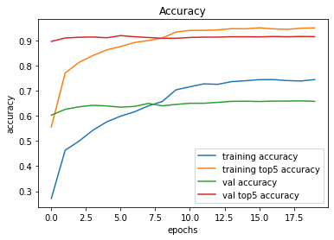
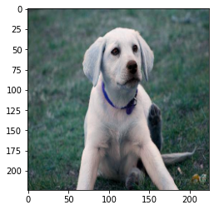
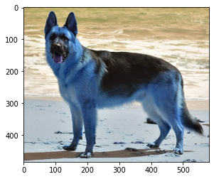
IDENTIFYING DOG BREEDS BASED ON VISUAL VARIATIONS IN APPEARANCE, USING CONVOLUTION NEURAL NETWORKS & TRANSFER LEARNING.
Debajyoti Das, Varun Sivasubramanian, Aranya Das
PGP-AIML(2019-21), Great Lakes Executive Learning
ABSTRACT
INTRODUCTION
DISCUSSION
The main objective of this capstone project is to identify & classify the breed of a dog, based on the subtle changes in its visual appearance.
The idea is to explore advanced computer vision techniques to intelligently & correctly predict the breed of a dog. Although most dogs confirm to certain visual traits that are unique to dogs, there are sometimes subtle & at time prominent features that help distinguish between different breeds of dogs. Humans are intuitively able to identify between different dog breeds, once they have been trained to look for distinguishable features between breeds.
In the current task we are trying to build a computer-vision based capability that helps computers to be also able to intuitively discern between dog breeds, without being clearly told what distinguishable features to look for.
A further challenge is such a large number of possible dog breeds, causes confusion even amongst humans to correctly label a dog breed. In this project, we also look to solve this problem using traditional computer vision approaches & transfer learning.
In our approach, we have tried multiple convolution neural network (CNN) architectures, varying from a CNN built by hand to using popular architectures like VGG-16, ResNet-50 & MobileNet. We have also tried techniques like Image Augmentation to see if the model performs better, or at times to understand if we can mitigate over-fitting.
The initial idea behind this project originated from a Kaggle Playground Prediction Competition hosted in 2017. In this playground competition, the candidates were provided with a strictly canine subset of ImageNet in order to practice fine-grained image categorization. The data-set had 120 breeds of dogs and a limited number training images per class. The goal of the competition was to create a classifier capable of determining a dog's breed from a photo.
Being pet-lovers, we took to this idea as to how we can use our knowledge on computer vision and build a model that would be able to successfully distinguish between different dog breeds. Breed classification is an especially difficult task, not just for dogs, but for most animals. This is also true for any such case where the number of distinct classes belonging to a single group is very large & there are often times not so discernible features to distinguish between classes. This is attenuated by the fact that available data-sets are susceptible to occlusions & various other optical challenges like lighting, angle, etc. & hence makes an already complicated task, even more challenging. Therefore, there are many challenges to be addressed and solved to integrate intuitive but accurate classification algorithms in such use cases
Tremendous progress has been made in fine-grained categorization with the advancement of deep CNNs. D. Steinkraus et. All ^{[16]} discusses data augmentation as an effective technique for improving the performance of CNNs when dealing with limited datasets. In our iterations, we have tried building our own custom CNN architecture but were only able to achieve a top-5 accuracy of 5%. We then ventured into transfer learning as these models were extensively trained on millions of images and might perform better than our custom models.
We observed that VGG-16 performed relatively well by achieving a top-5 accuracy of 60% in contrast to the Resnet-50 model that showed a top-5 accuracy of 19% (after making all its layers trainable). Both these models still performed much better than our custom CNN model with only a few layers.
And finally, to our surprise, we saw that the more compact and lighter mobilenet V2 architecture, that was pre-trained, saw a remarkable top-5 accuracy of 94%, although, we did notice that the mobilenet V2 model was highly overfit, without image augmentation, with a staggering 30% difference between training accuracy & testing accuracy. On using image augmentation we see that there is very little overfit, as the difference between top-1 accuracies in the training and test data came down to about 7% (72% and 65% respectively.
Figure 1. Sample Images from the dataset, showing the 3 versions of image extracted: grayscale with 128X128, color (bgr) with 128X128 & color (bgr) with 224X224
Figure 2. Model architectures for custom CNN, VGG16, Resnet50 & MobileNet
Figure 3: Learning Curve for Mobilenet V2 with pre-trained weights and Image Augmentation
Actual Dog Breed: ['labrador_retriever’]
Predicted Dog Breed: ['labrador_retriever']
Actual Dog Breed: [‘german_shepherd’]
Predicted Dog Breed: [german_shepherd ']
Figure 4. Sample predictions of the model on a few images in our dogs dataset
METHODS AND MATERIALS
The data-set used for this project was hosted by Kaggle, as part of their Kaggle Playground Prediction Competition in 2017. The dataset was actually created as Stanford Dogs Dataset, and it is a strictly canine subset of ImageNet created for the task of fine-grained image categorization. The dataset comprises of 120 breeds of dogs and a limited number training images per class. Each image was assigned a unique id and the same was tagged against the breed the dog in the image belonged to in a separate csv file
We have tried 3 types of image resizing techniques before feeding to our models:128X128X1, 128X128X3, 224X224X3
We have predominantly used 80:20 split for training & validation sets, but in the last iteration we have also tried to build the model on 90:10 split. We have throughout used only 10000 of the total 10222 records for training & validation.
RESULTS
CONCLUSIONS
Model | Model Name | Image Augmentation (Y/N) | Training Accuracy | Validation Accuracy | Val Top 5 Accuracy | ROC-AUC Score
1 | Custom CNN Architecture | N | 1.23% | 1.08% | 5.23% | 0.50
2 | Custom CNN Architecture | Y | 1.24% | 0.99% | 4.86% | 0.49
3 | VGG-16 with pre-trained weights | N | 99.96% | 29.34% | 60.54% | 0.92
4 | VGG-16 with pre-trained weights | N | 54.76% | 25.23% | 53.89% | 0.92
5 | VGG-16 with pre-trained weights | Y | 21.35% | 19.39% | 47.72% | 0.89
6 | Resnet-50 using pre-trained weights | N | 1.15% | 0.75% | 5.05% | 0.5
7 | Resnet-50 using pre-trained weights | Y | 1.09% | 0.76% | 5.04% | 0.5
8 | Resnet-50 with all layers trainable | N | 5.92% | 4.80% | 18.75% | 0.77
9 | Mobilenet V2 with pre-trained weights | N | 99.96% | 71.40% | 93.65% | 0.99
10 | Mobilenet V2 with pre-trained weights | Y | 74.9% | 65.78% | 91.53% | 0.99
11 | Mobilenet V2 with pre-trained weights on 90:10 split | N | 98.9% | 67.10% | 91.2% | 0.99
12 | Mobilenet V2 with pre-trained weights on 90:10 split | Y | 71.62% | 65.12% | 91.94% | 0.99
Given the computational constraints, we had to be very careful about running the models. The models couldn’t be executed in serial as the image pre-processing required for each set of models, especially expanding the images as float32 arrays would occupy a lot of memory, and hence we had to execute the models in batches based on the image pre-processing required for each
We initially started with overall accuracy as an evaluation metric, but very soon shifted to roc-auc considering the diversity of the classes and skewness of distribution of records between them. We finally also included top-5 accuracy as a benchmarking measure, as based on the above diversity of the classes and skewness of distribution of records, even a model which has a 90% plus top-5 accuracy could be potentially considered as an excellent solution candidate.
Most models, even if they were trained on ImageNet performed very poorly in all of the evaluation metrices, even if the model was retrained on the current data. Only the MobileNet V2 model pre-trained specifically for the current task, performed well.
MODEL
Custom models trained on 128X128 grayscale images with & without Image Augmentation
VGG-16 models with & without pre-trained weights, trained on 128X128 colour (BGR) images with & without Image Augmentation
Pre-trained Resnet50 models, trained on 224X224 colour (BGR) images with & without Image Augmentation.
Best model was pre-trained MobileNet models, trained on 224X224 colour (BGR) images with & without Image Augmentation. Trained on 80:20 split and 90:10 split of the training data.
REFERENCES
X. Wang, V. Ly, S. Sorensen, and C. Kambhamettu, “Dog breed classification via landmarks,” in 2014 IEEE International Conference on Image Processing (ICIP), 2014
Vipul Jain andDr. Bhoomi Gupta, “End-to-end multiclass dog breed classification,” December 2020, vol. 6, no. 12, pp. 87–92, 2020
C. Wang, J. Wang, Q. Du, and X. Yang, “Dog breed classification based on deep learning,” in 2020 13th International Symposium on Computational Intelligence and Design (ISCID), 2020
A. Konno, T. Romero, M. Inoue-Murayama, A. Saito, and T. Hasegawa, “Dog breed differences in visual communication with humans,” PLoS One, vol. 11, no. 10, p. e0164760, 2016
“Stanford Dogs Dataset,” Stanford.edu. [Online]. Available: http://vision.stanford.edu/aditya86/ImageNetDogs/. [Accessed: 13-Mar-2021]

